Slide 1
Diagnostic Report Meta-Analysis
Module: Best Practice R
Torfinn Belbo & Carolina Wackerhagen

Slide 2
Meta-Analysis
Steps to include (according to Koricheva & Gurevitch, 2014 *):
Weighting of effect sizes across studies
Exploring the cause of heterogeneity
Test for publication bias
Sensitivity analysis
(Account for phylogeny)
* Koricheva, J., & Gurevitch, J. (2014). Uses and misuses of meta‐analysis in plant ecology. Journal of Ecology, 102(4), 828-844.

Slide 3
What We Did in R
Weighting of effect sizes
Integrated in rma function
Exploring the cause of heterogeneity
Adding moderators in rma function (meta regression)
Test for publication bias
Funnel plot, Fail-Safe N analysis
Sensitivity analysis
Leave1out analysis

Slide 4
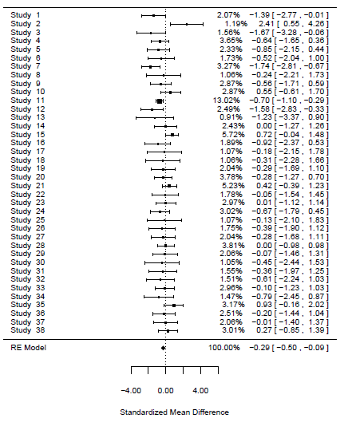
Meta-Analysis in one slide: Forest plot!
Dataset: Gibson et. al 2011
Subset with only bird taxon
Only 1 species per study selected (randomly)
From n=2220 to n=38, so extremely simplified
The steps presented in the slide before implemented
And voila! Here’s our result!
More figures can be shown on request

Slide 5
The Next Two Weeks
What we should do:
R-script more or less sorted out
Automize the meta analysis/diagnostic report
Include more fancy stuff if we have time (make an R function)
Questions we have:
Where to start?
How to make an automated appendix?
Meta-analysis is not a standardized procedure!

